Slide 1
VaultViewer Bo Vermote

Slide 2
Introductie
Probleem
Oplossing?

Slide 3
Requirements
Login & User & Admin panel
Role-based access
Hashing & encrypting connecting string(s)
Dynamic MySQL based filtering/sorting
Separation of concerns (layered-architecture)
User friendly (non IT people)

Slide 4
Aanpak
Analyse & uitschrijven van requirements
Wireframing UI/class diagrams
Functionaliteiten stapsgewijs opbouwen
Bugfixing

Slide 5
Solo-aanpak
Git
Trello
Leren on the fly – LINQ, databinding, XAML, Lambda

Slide 6
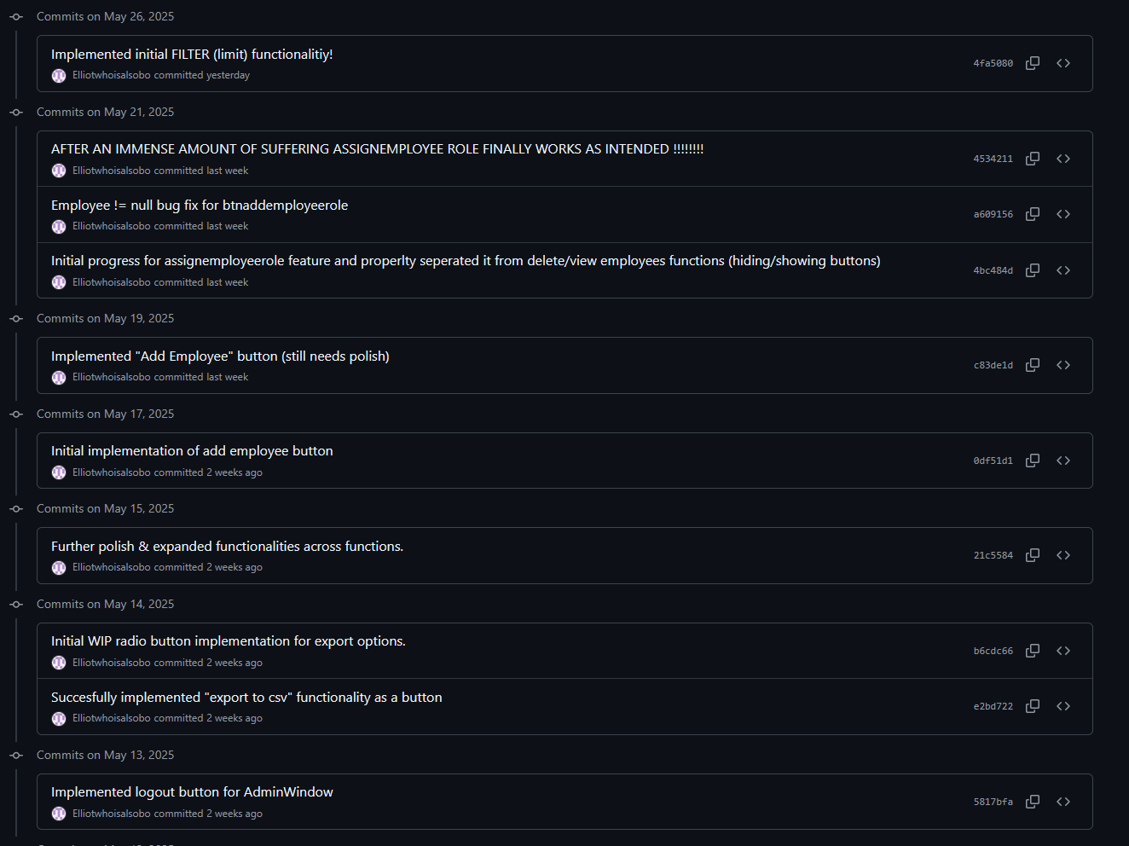


GIT

Slide 7
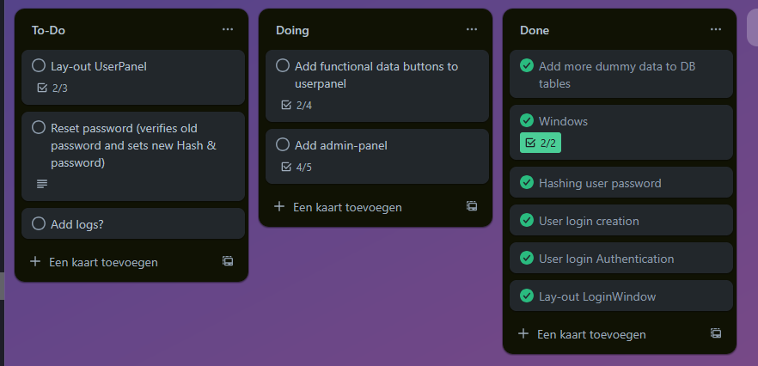
Trello

Slide 8
Approach
A solo journey with coaching on:
Design pattern implementation
Design principles
Complex lambda expressions
Notes:
STARTED EARLY !!!

Slide 9
Results
Login panel: Test database connection, create login, login, exit app
User panel: View/sort/filter/export (csv, excel) data, logout
Admin panel: Create & delete & assign roles to Employees
Partial implementation of layered-architecture (service & DataRepository mixed)
Hashed passwords, smart deletion, hosted db
A nice & clean UI/Design : )

Slide 10
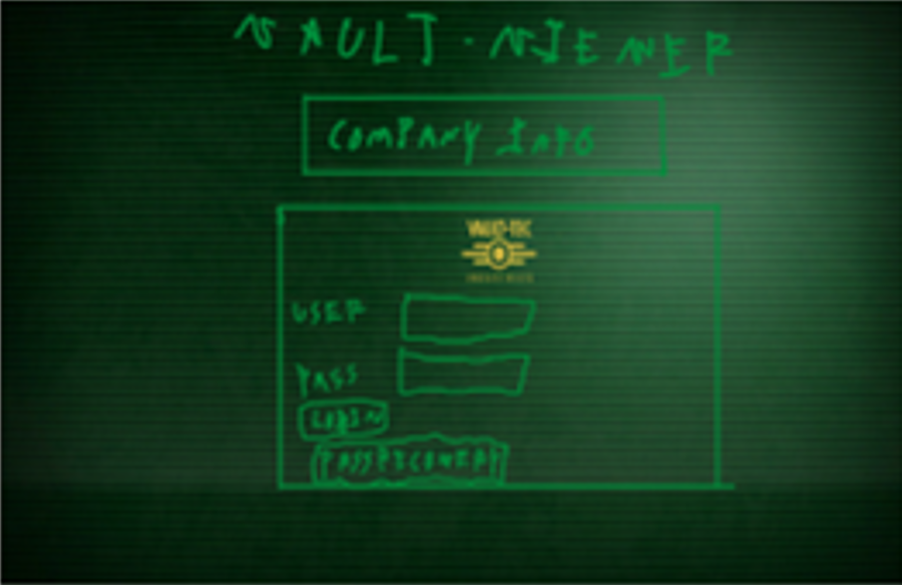
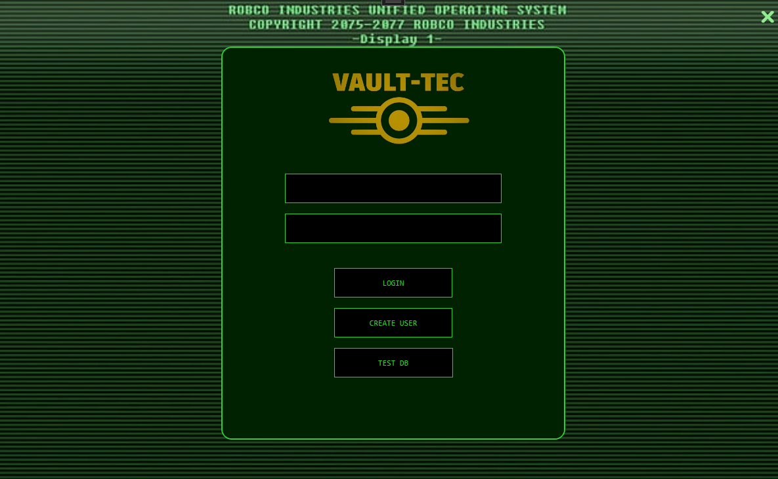
Wireframe & result Login

Slide 11
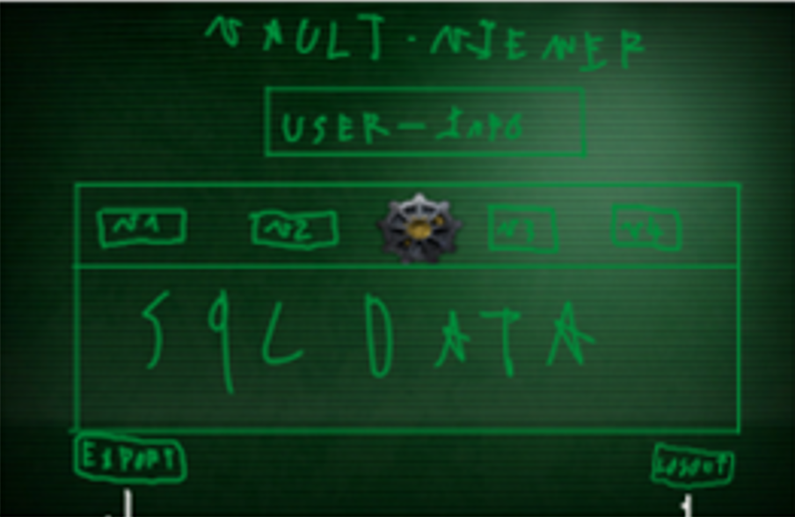
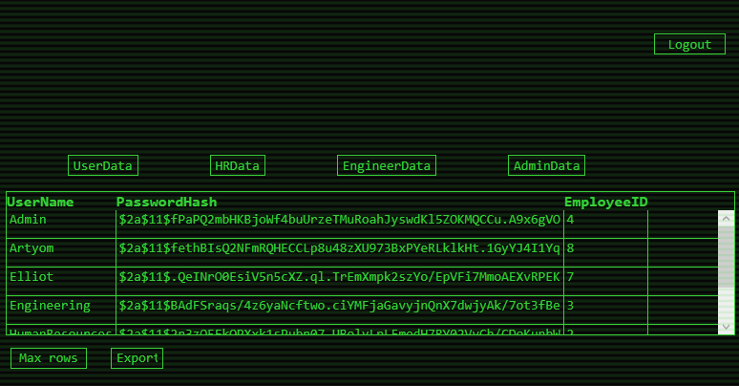
Wireframe & result UserPanel

Slide 12
To-Add
Logs (additional mysql table with DeletedUser/CreatedUser (tinyInt)
Reset password
Proper adherence to design pattern & principles

Slide 13
What did I learn?

Slide 14
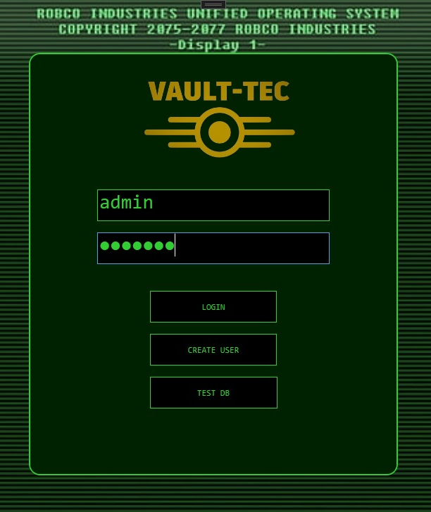
Demo time & handouts

